Slide 1
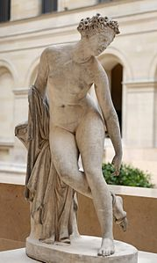
Notes:
Leboeuf, Dying Eurydice,1822 (Louvre)

Slide 2
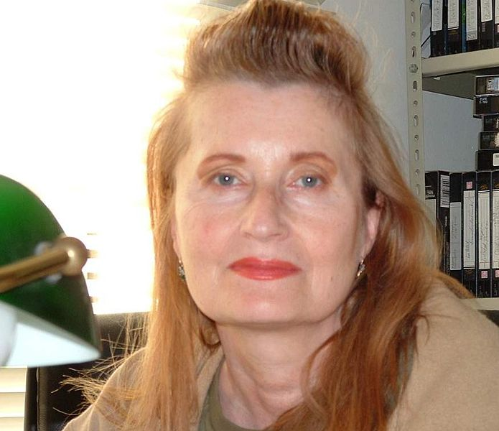
Notes:
Elfriede Jelinek (1946 - )

Slide 3
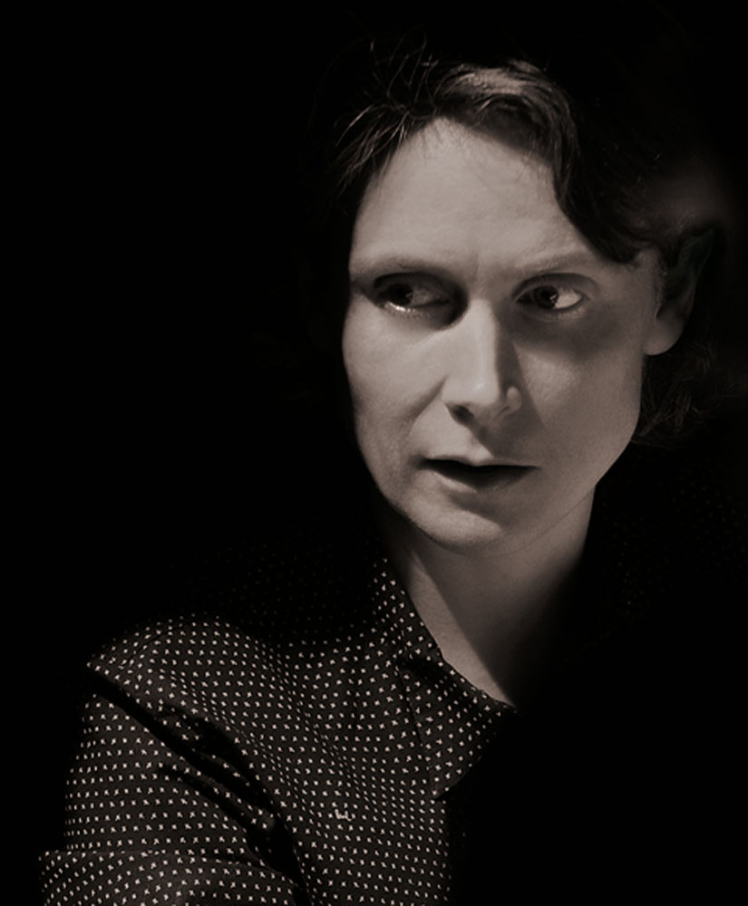
Notes:
Katie Mitchell (1964 - )

Slide 4
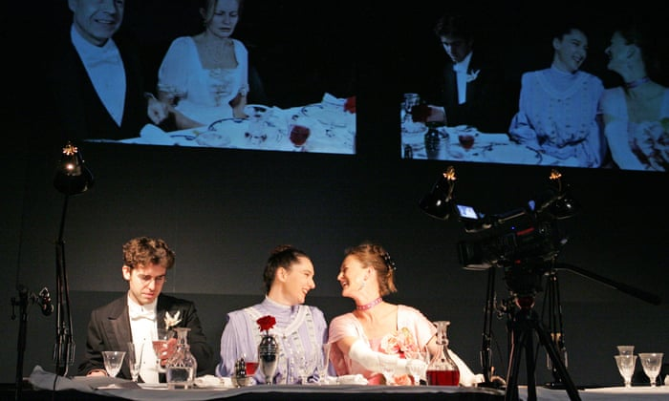
Notes:
The Waves, de V. Woolf, dir. Katie Mitchell, 2007.

Slide 5
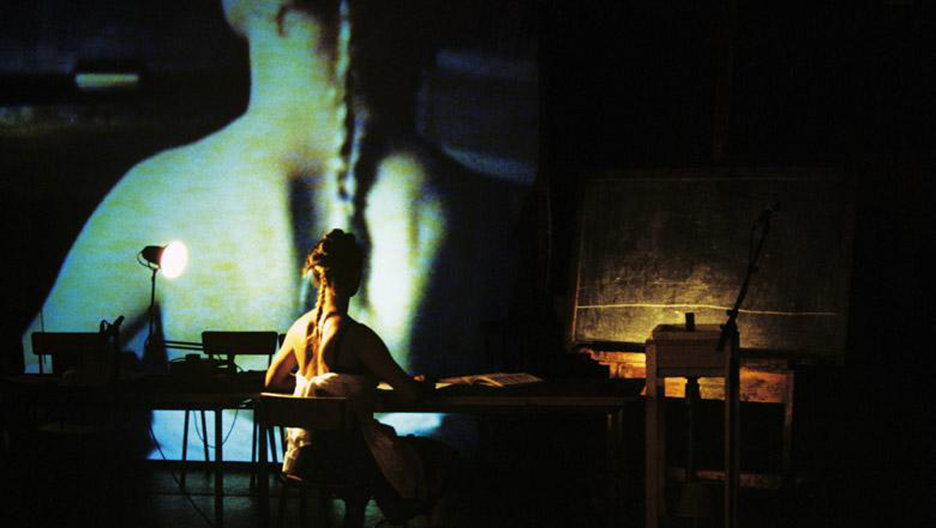
Notes:
The Waves, de V. Woolf, dir. Katie Mitchell, 2007.

Slide 6
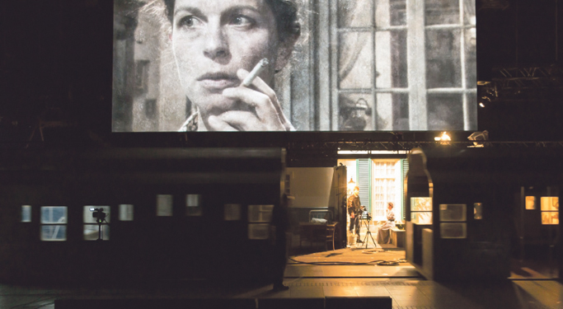
Notes:
The Forbidden Zone, dir. Katie Mitchell, 2014.

Slide 7
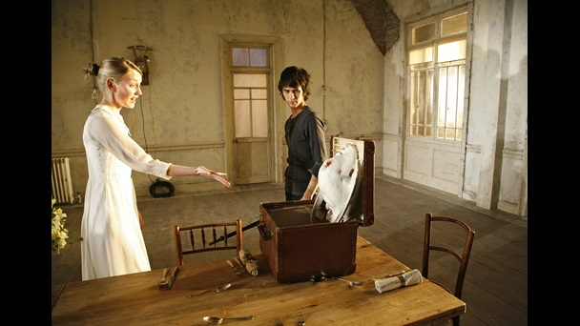
Notes:
La gavina, de Txèkhov, dir. Katie Mitchell, 2006.

Slide 8
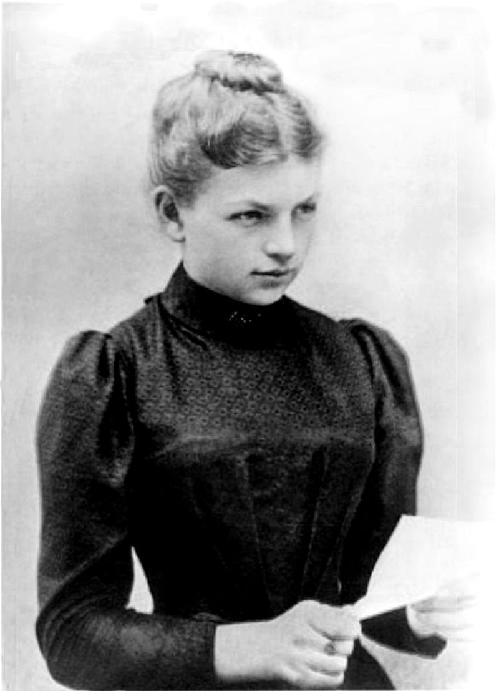
Notes:
Clara Immerwahr

Slide 9
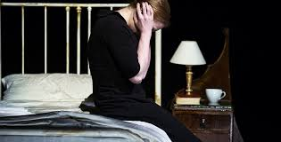
Notes:
Ophelia’s Zimmer, dir. Katie Mitchell, 2016.

Slide 10
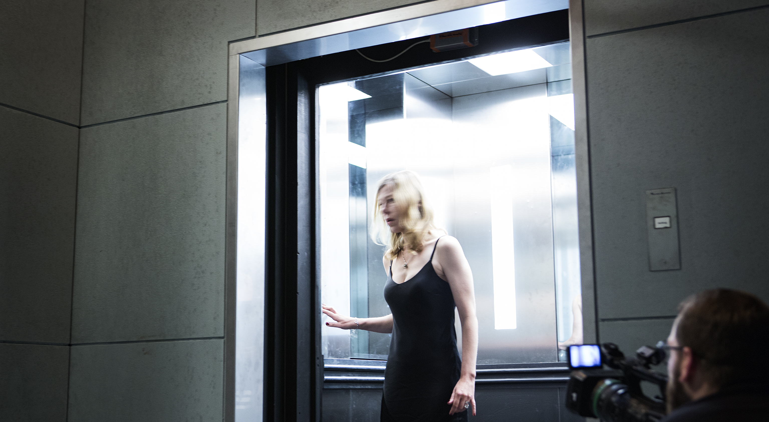
Notes:
Shadow, d’Elfriede Jelinek, dir. Katie Mitchell, 2016.

Slide 11
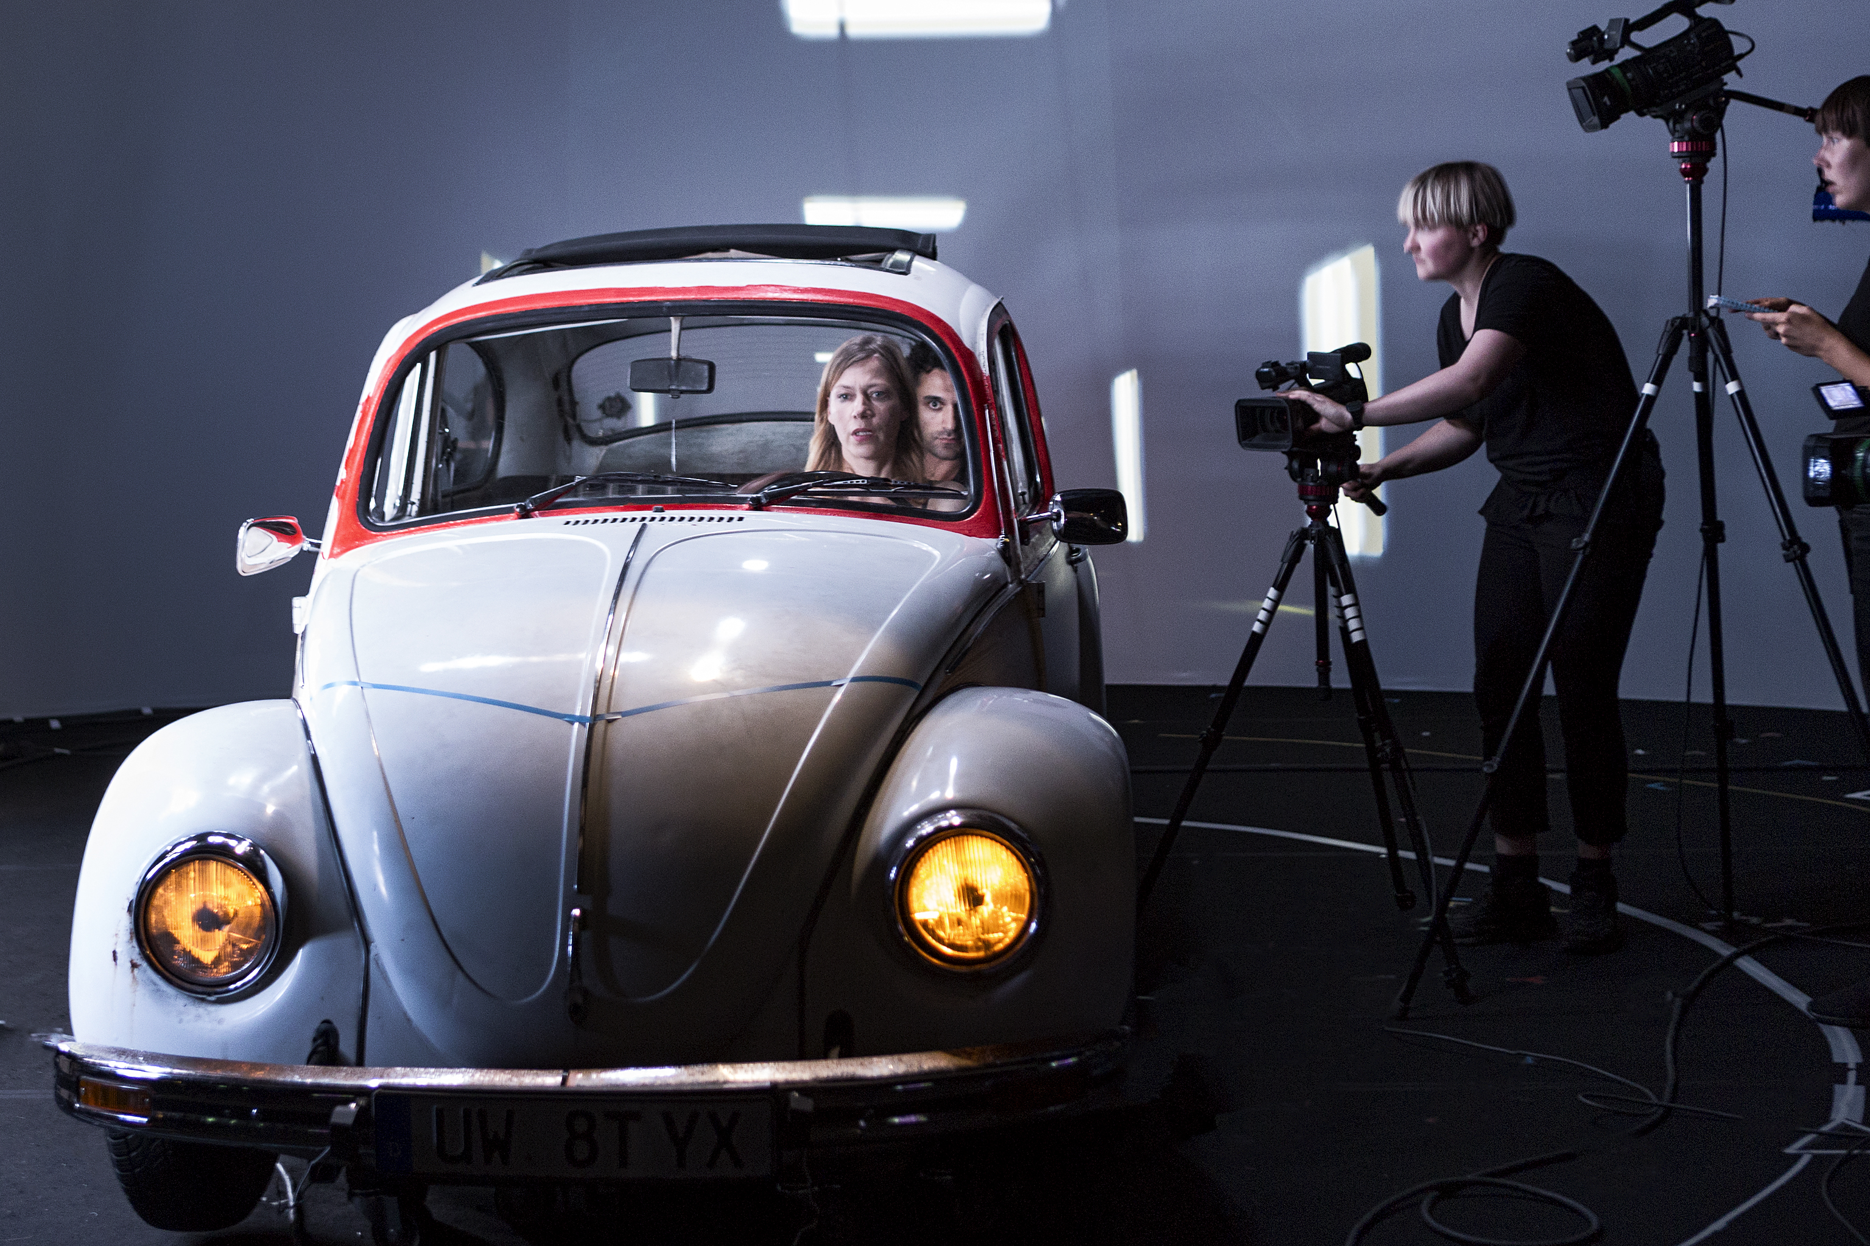
Notes:
Shadow, d’Elfriede Jelinek, dir. Katie Mitchell, 2016.

Slide 12
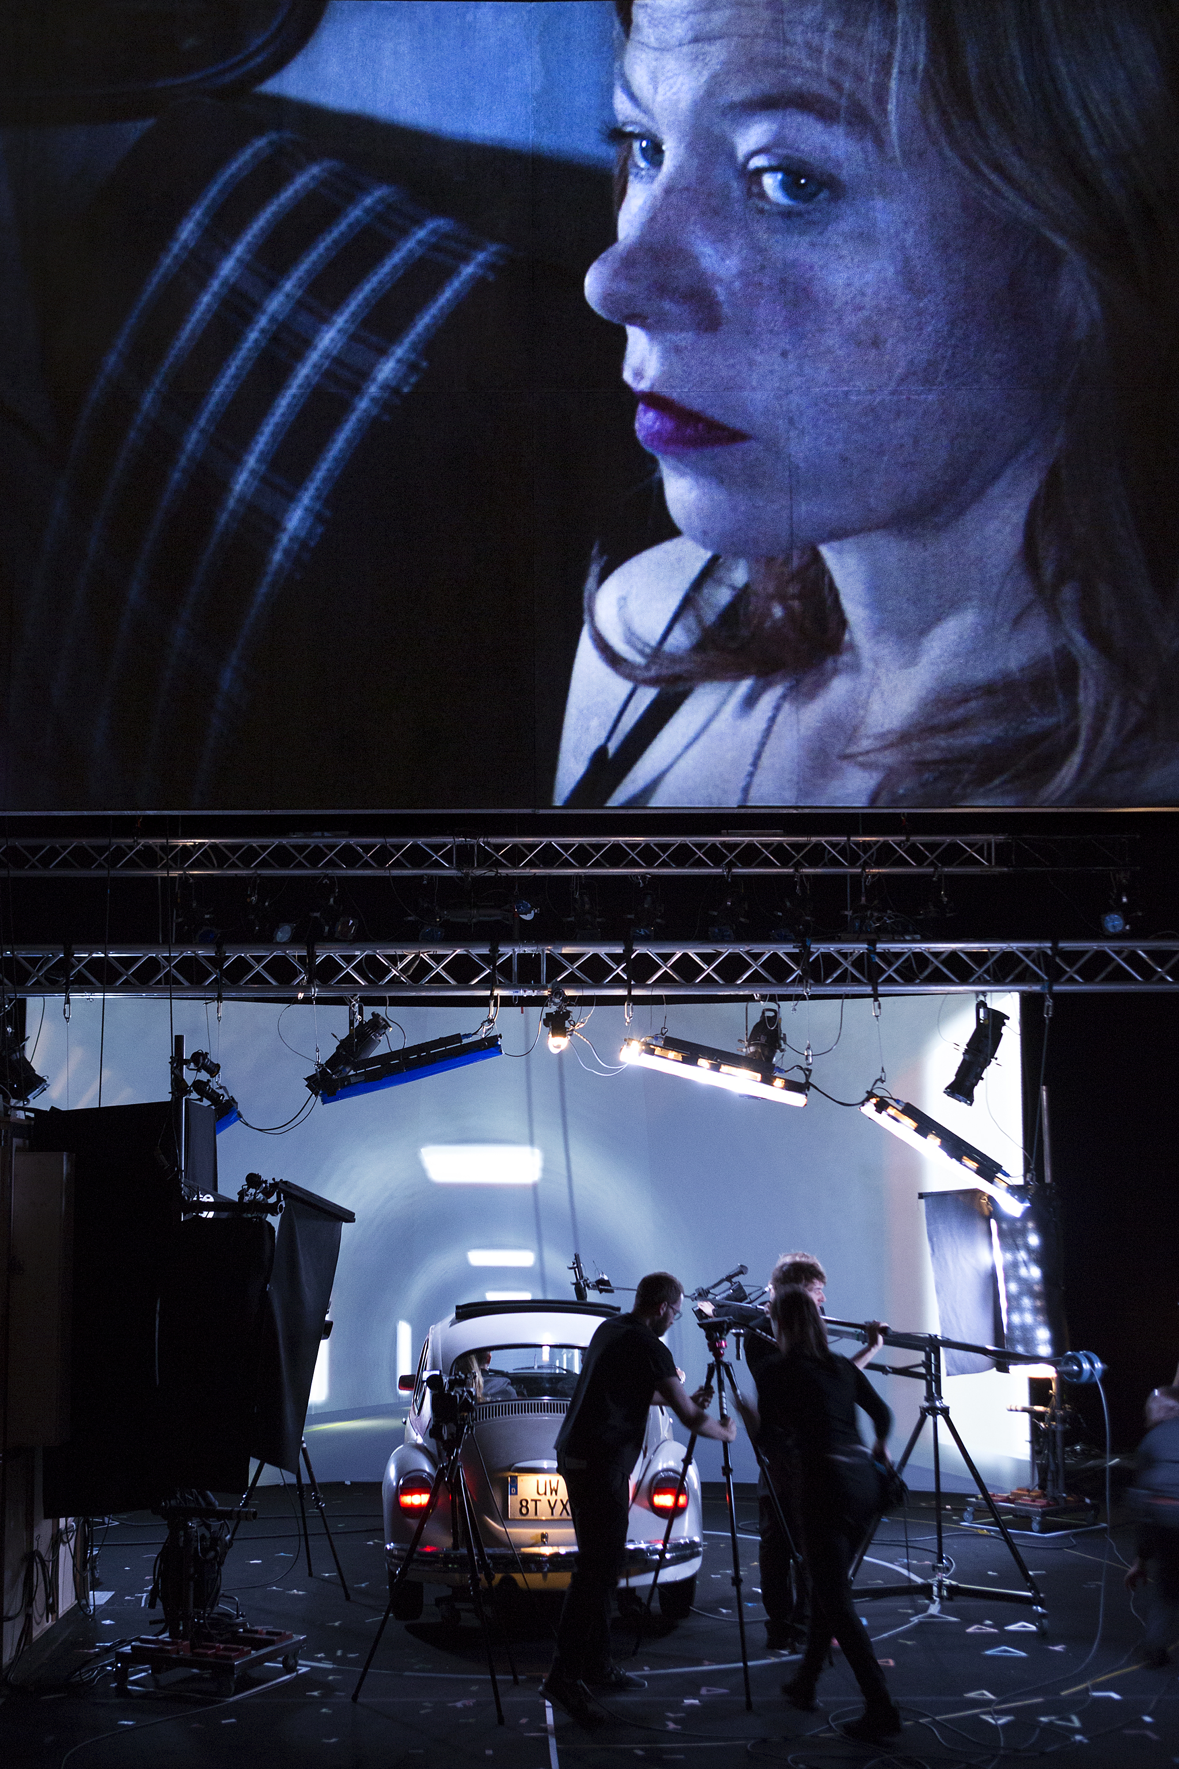
Notes:
Shadow, d’Elfriede Jelinek, dir. Katie Mitchell, 2016.

